Slide 1
Applied Statistics Exercise
June 18, 2021

Slide 2
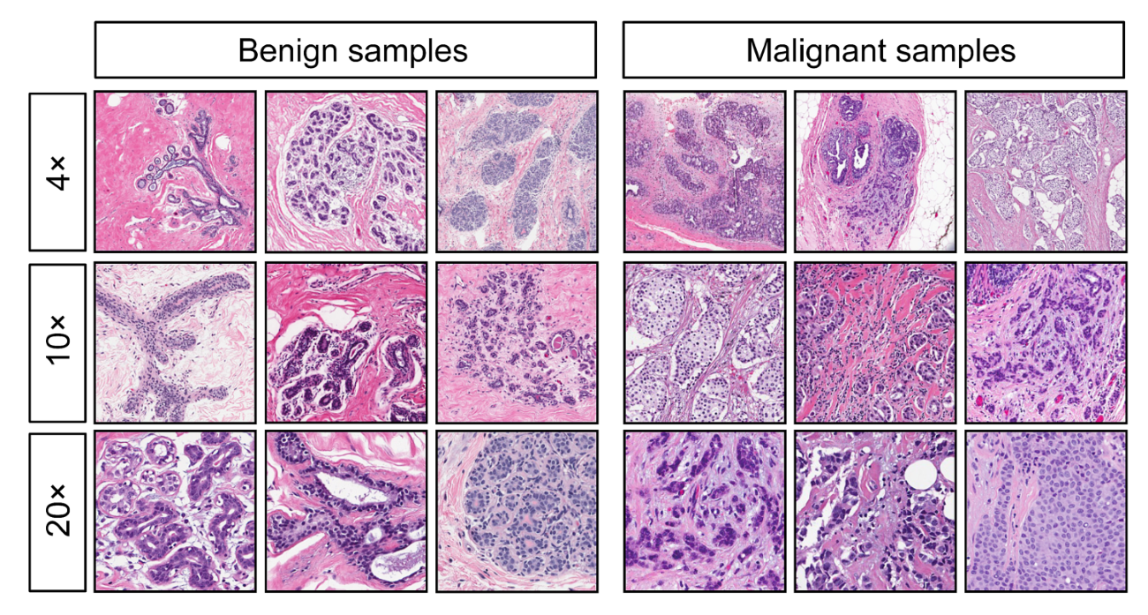
Case: Wisconsin Breast Cancer Dataset

Slide 3
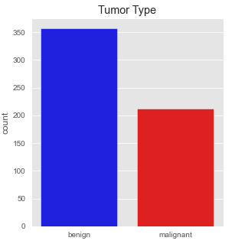
Use Case: Wisconsin Breast Cancer Dataset
Problem: Explore the difference of benign and malignant tumors based on the diagnostic features
Benign tumors - they form only in one spot without spreading to surrounding tissue
Malignant tumors - they are cancerous and can spread to nearby tissue
CONFIDENTIAL © 2020 MDI NOVARE, Inc. All rights reserved.
Notes:
Goal: profiling their customers as to show signs of improvement understanding on the customers paying conduct
To analyse the patterns of paying behavior of the customers
To identify the features or variables of customers on paying electricity
To determine the most suitable data mining model based on identified variables

Slide 4
Use Case: Wisconsin Breast Cancer Dataset
This Task: Explore the difference of benign and malignant tumors
Perform descriptive statistics and the relevant exploratory data analysis methods to analyzed the dataset
Perform hypothesis testing by answering the following:
Do those with ‘malignant’ tumors have bigger ‘mean area’ on average than those with ‘benign’ tumors?
Find correlation between mean texture and mean perimeter for those with malignant tumors.
CONFIDENTIAL © 2020 MDI NOVARE, Inc. All rights reserved.
Notes:
Goal: profiling their customers as to show signs of improvement understanding on the customers paying conduct
To analyse the patterns of paying behavior of the customers
To identify the features or variables of customers on paying electricity
To determine the most suitable data mining model based on identified variables

Slide 5
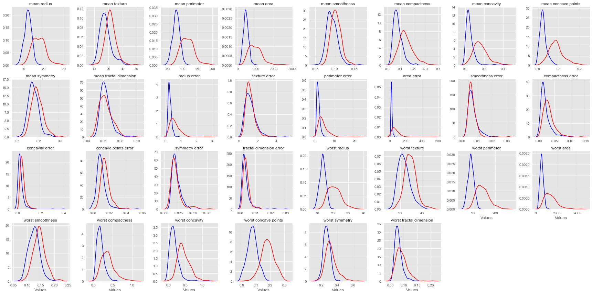
Use Case: Wisconsin Breast Cancer Dataset
Exploratory Data Analysis
CONFIDENTIAL © 2020 MDI NOVARE, Inc. All rights reserved.
Notes:
Goal: profiling their customers as to show signs of improvement understanding on the customers paying conduct
To analyse the patterns of paying behavior of the customers
To identify the features or variables of customers on paying electricity
To determine the most suitable data mining model based on identified variables

Slide 6
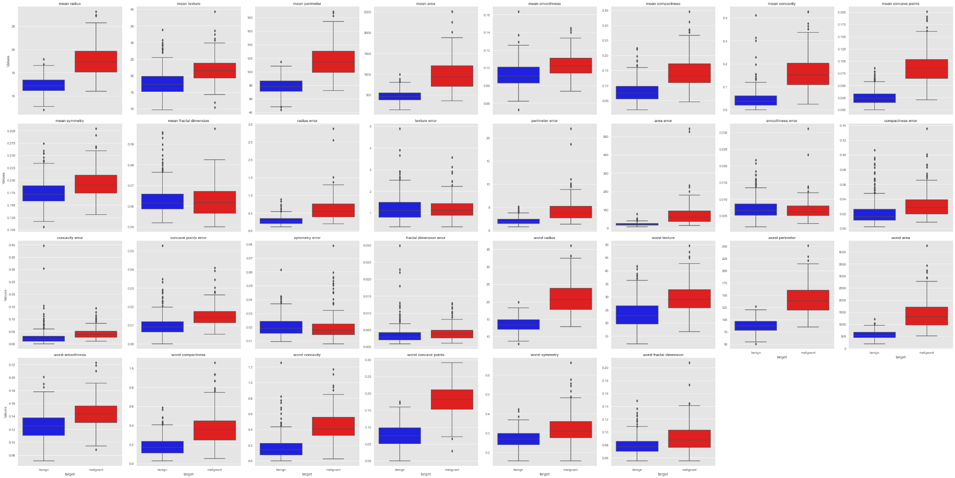
Use Case: Wisconsin Breast Cancer Dataset
Exploratory Data Analysis
CONFIDENTIAL © 2020 MDI NOVARE, Inc. All rights reserved.
Notes:
Goal: profiling their customers as to show signs of improvement understanding on the customers paying conduct
To analyse the patterns of paying behavior of the customers
To identify the features or variables of customers on paying electricity
To determine the most suitable data mining model based on identified variables

Slide 7
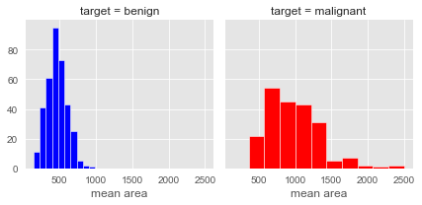
Use Case: Wisconsin Breast Cancer Dataset
Do those with ‘malignant’ tumors have bigger ‘mean area’ on average than those with ‘benign’ tumors?
Null Hypothesis: mean area of ‘malignant’ tumors is less than and equal to those with ‘benign’ tumors
Alternative Hypothesis: mean area of ‘malignant’ tumors is greater than those with ‘benign’ tumors
Results:
Test Stat: 19.6861
p-value (right-tailed): 1.3310e-52
critical value of t: 1.6511
Reject the null hypothesis (alpha = 0.05)
Have enough evidence that the ‘malignant’ tumors have bigger ‘mean area’ than those with ‘benign’ tumors
CONFIDENTIAL © 2020 MDI NOVARE, Inc. All rights reserved.

Slide 8
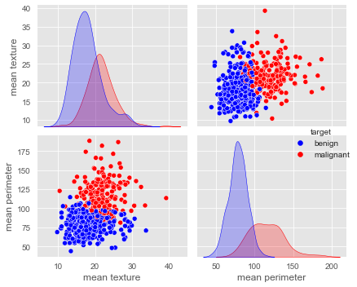
Use Case: Wisconsin Breast Cancer Dataset
Find correlation between mean texture and mean perimeter for those with malignant tumors.
Correlation = 0.1107
Low Positive Correlation
CONFIDENTIAL © 2020 MDI NOVARE, Inc. All rights reserved.

